Slide 1
Presentation on credit eda case study
Nikhil Bhati
Tanudeep BM

Slide 2
Problem statement
The loan providing companies find it hard to give loans to the people due to their insufficient or non-existent credit history. Because of that, some consumers use it as their advantage by becoming a defaulter. Suppose you work for a consumer finance company which specializes in lending various types of loans to urban customers. The EDA has to performed on the given dataset to ensure the applicants that are capable to repay the loan are not rejected

Slide 3
purpose
Credit risk analysis will help the company to make decision for loan approval of different client’s profile that controls loss of business to company and avoid finaincial loss

Slide 4
Steps to be followed
Understanding the data and sourcing with importing the necessaries python libraries.
Data cleaning: if any a column or rows have maxium null values such the irrelevant data should be removed from data set
If data set contains minimum null value that can be replaced with mean or median values.
Finding outliers and binning of continuous variables.
Univariate analysis and bivariate analysis on application_dataset
Univariate analysis and bivariate analysis on previous_application_dataset
Merging both the dataset
Categorical analysis on merged dataset

Slide 5
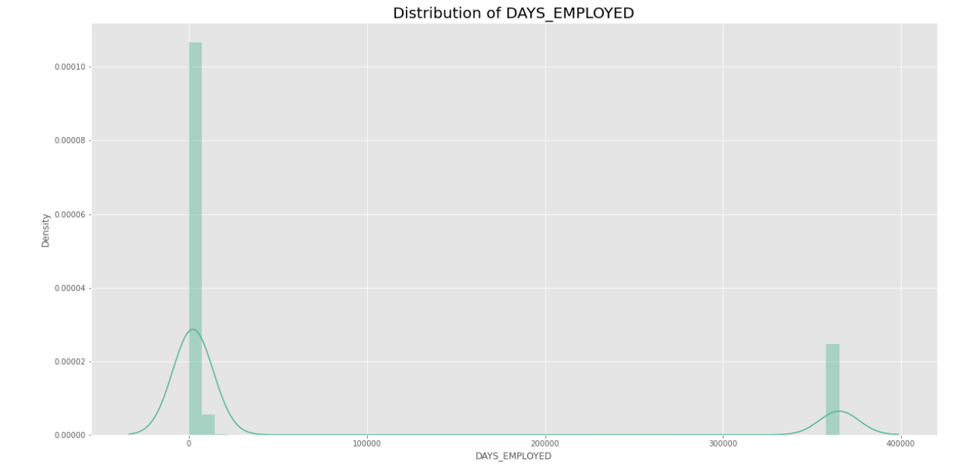
Here, in the coloumn 'DAYS_EMPLOYED' which tells how many days before the application the person started current employment. We observe a value which is greater that 20,000 which is surely an outlier because 25,000/365 will be around 54 years. Considering that a person started working at ag e of 21, the person will be 21+54 will turn out to be 75 years old.

Slide 6
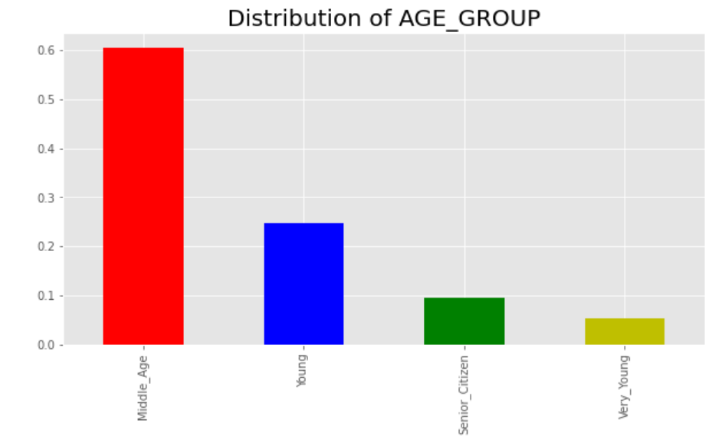
As we can see clearly in the above bar chart middle age people applied the most for the loans as in the direct comparison with the very young population which has applied the least.

Slide 7
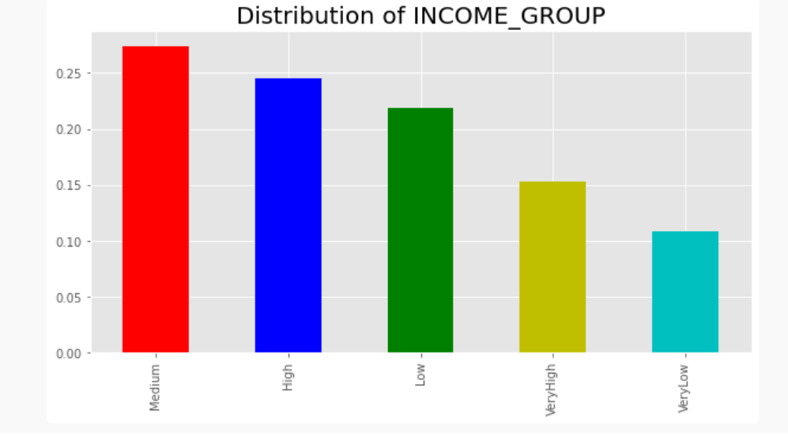
As per the above diagram population with the Medium Income Group has applied more for the loans to cover expenses and also due to the capacty to pay pack on the other hand people with very low income has applied for the loan least due to the less pay back capacity as compared to the others.

Slide 8
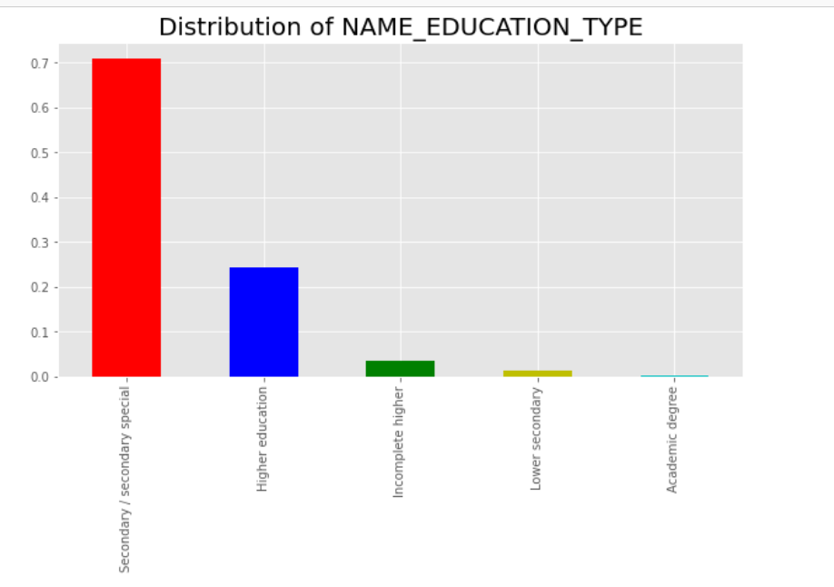
As per the above graph applicants with Secondary / Seconday Special are the most in number which points in the direction that they can be in the age group of either Young or higher and probably are working or has a business to be to apply for the loans to be able to repay

Slide 9
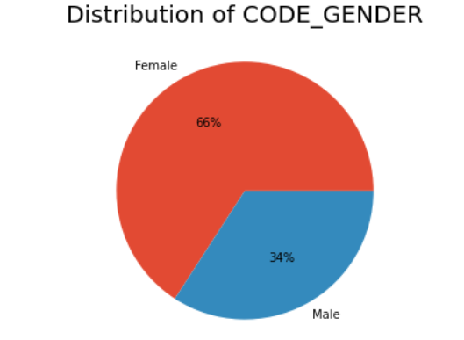
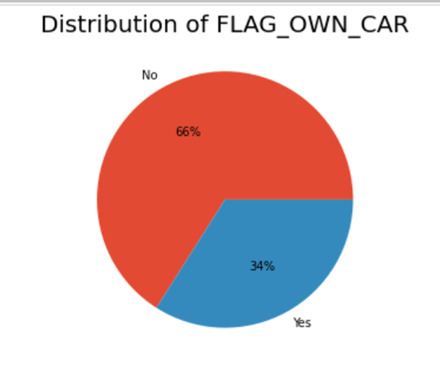
As per the graph the 2/3 of the new applicants are females whereas males are only 1/3. Huge gender ratio difference.
As per the Pie Chart the direct comparison between people who owns a car and people who doesn't owns a car has a huge difference which is 1/3 of people who applied for the loan owns the car where as 2/3 of the people doesn't. The probable cause for taking the loan could be a car purchase for the people who doesn't own car

Slide 10
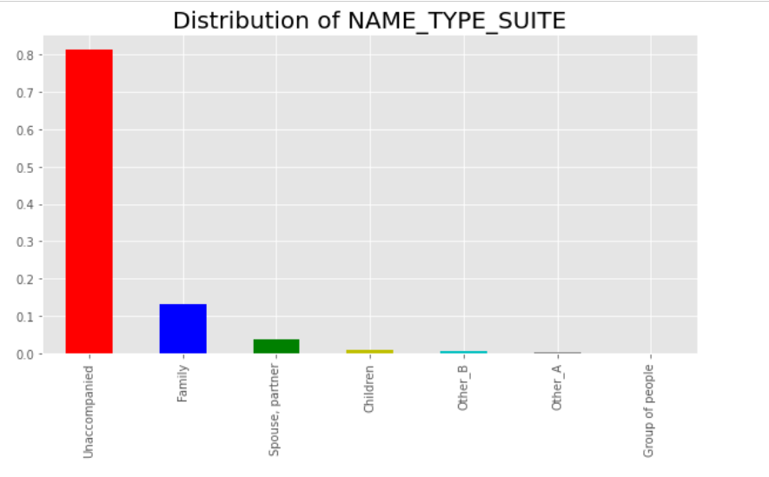
As per the above graph above 80% of the applicants have applied for the loan unaccompanied

Slide 11
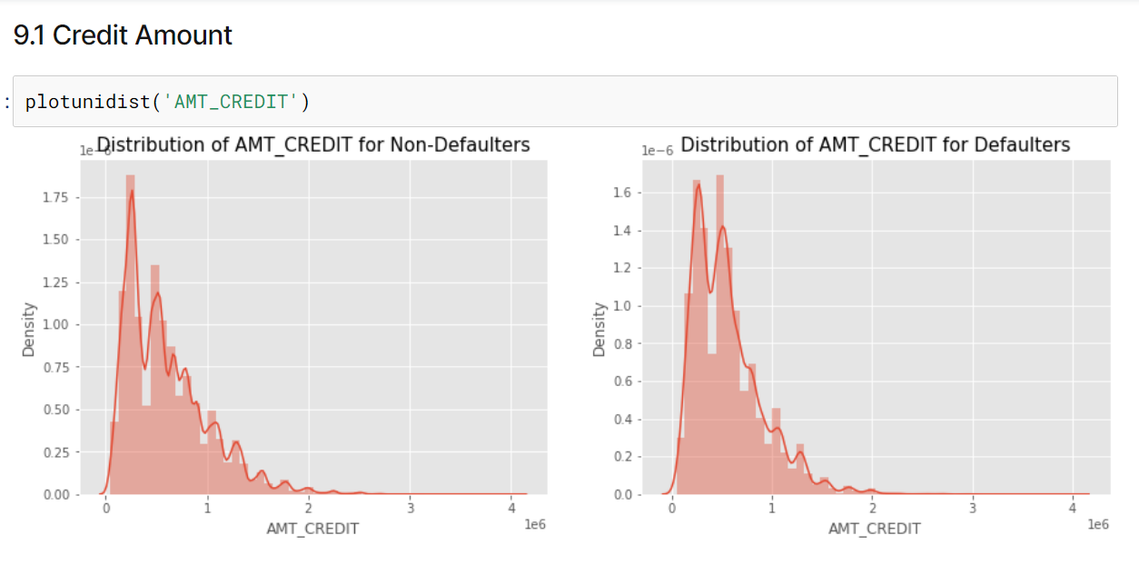
As shown in figure comparison highest density is in the Non- defaulters but in over all comparison Defaulters seems to be more overall combined density as compared to the non defaulters. Although it is not much clear to put such statements.

Slide 12
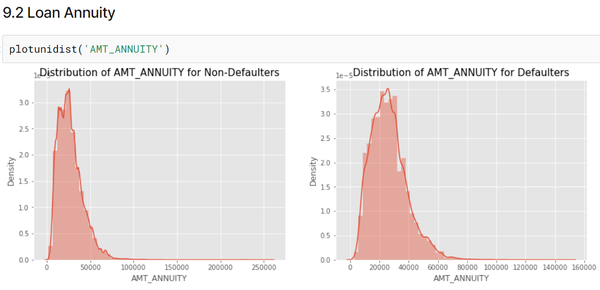
As per the above graph the Loan returned after a set period of time is allot more by defaulters as compared to the non-defaulters.

Slide 13
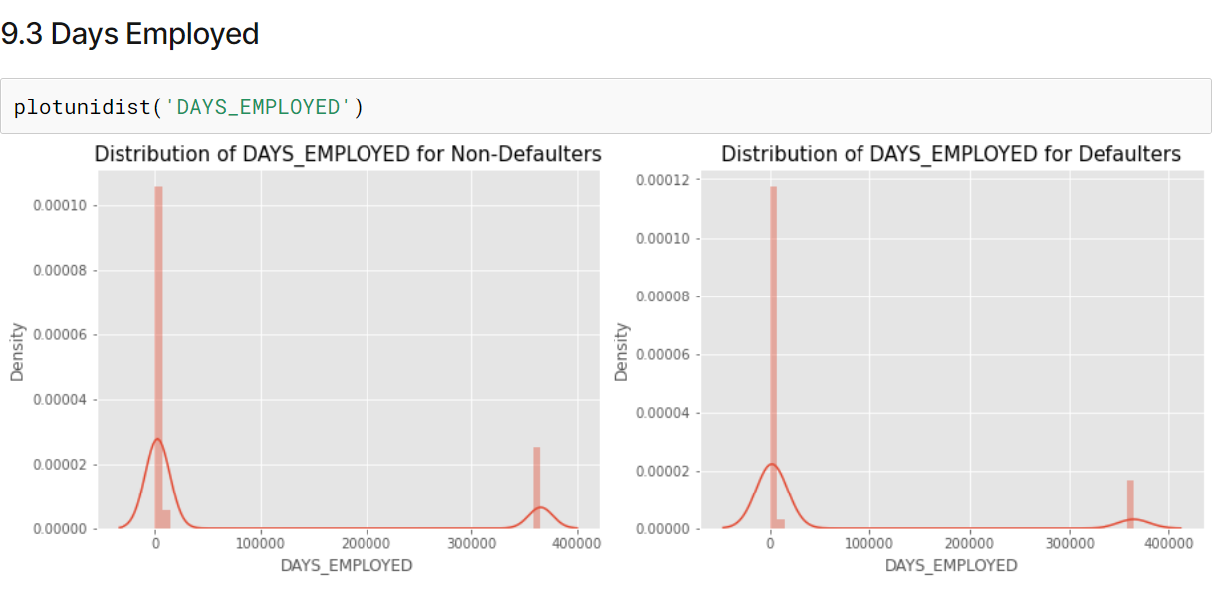
The Density of the Non-Defaulters is more than the defaulters but days employed is more in defaulters as compared the non defaulters.

Slide 14
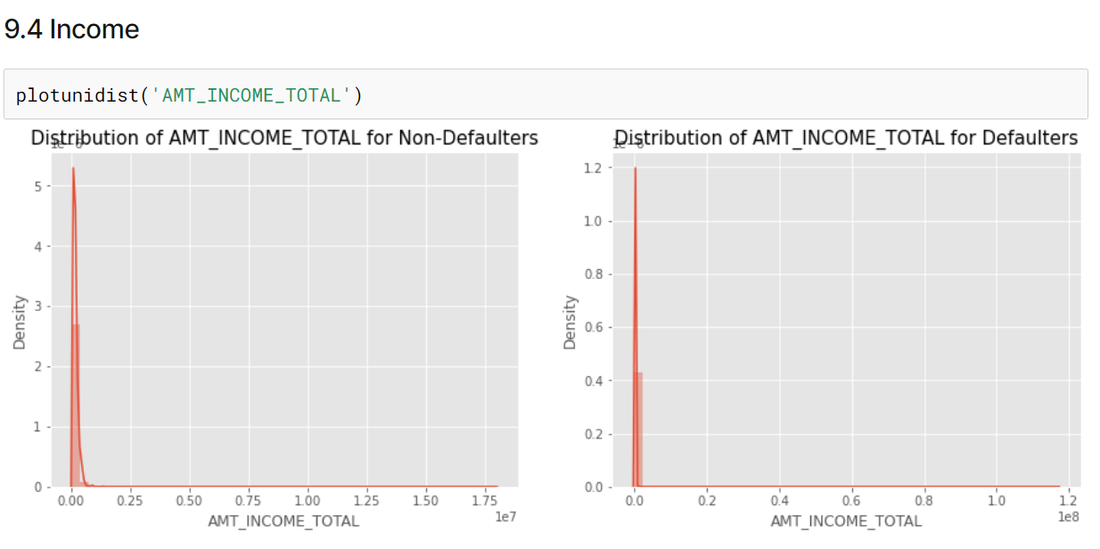
Graph is not much clear but one noticable thing is that the income of the non-defaulters is higher as compared to the defaulters.

Slide 15
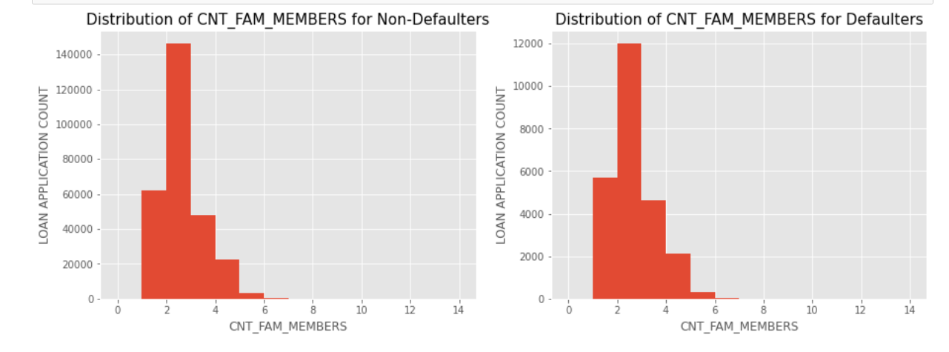
We can see that a family of 3 applies loan more often than the other families

Slide 16
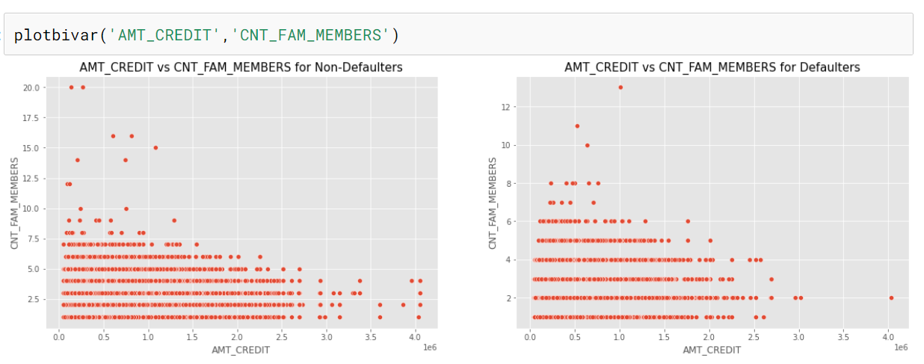
As we can see the left graph is a bit more dense as compared to the right. Non-Defaulters have highest Family members count as compared to the defaulters.

Slide 17
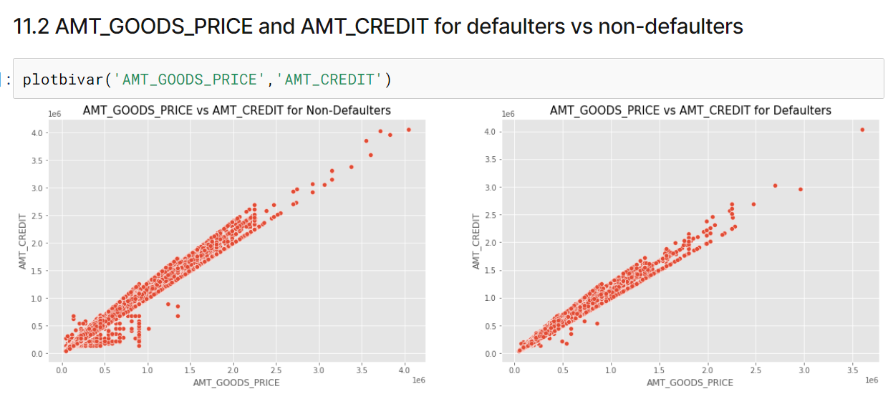
As we can see in the above graphs the Non- defaulters is much denser which also indicates that the credit amount and the good price chances as higher for the non defaulters

Slide 18
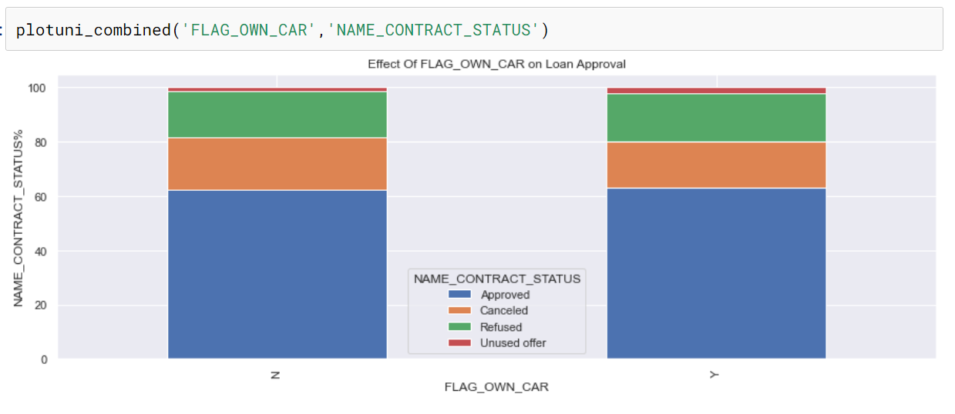
We see that car ownership doesn't have any effect on application approval or rejection. But we saw earlier that the people who has a car has lesser chances of default. The bank can add more weightage to car ownership while approving a loan amount

Slide 19
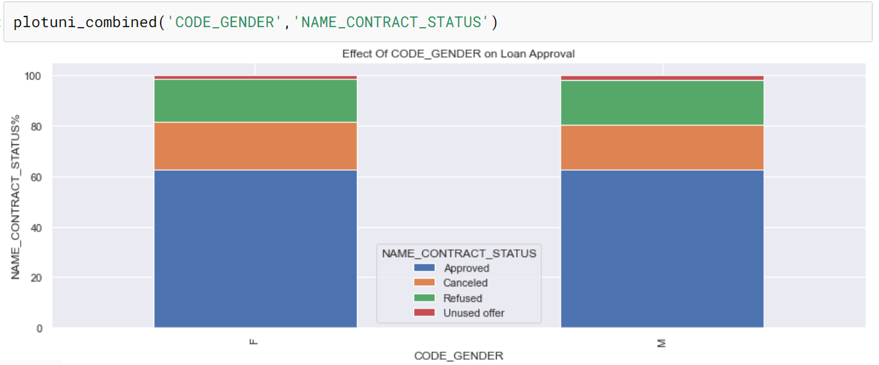
We see that code gender doesn't have any effect on application approval or rejection. But we saw earlier that female have lesser chances of default compared to males. The bank can add more weightage to female while approving a loan amount

Slide 20
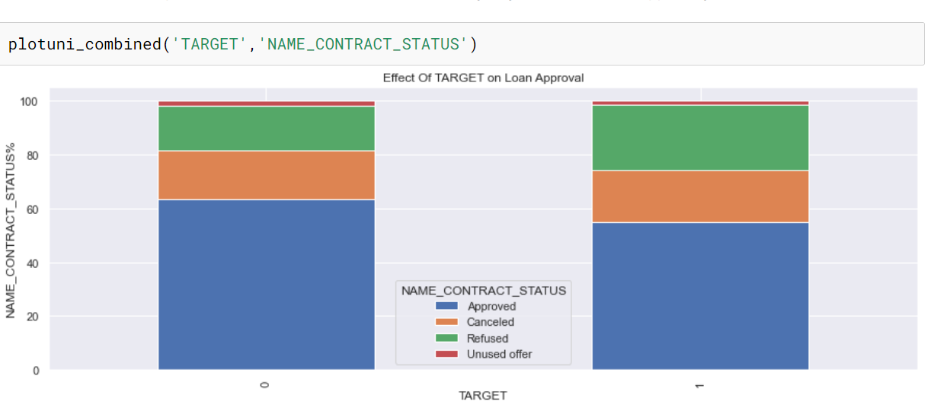
Target variable (0 - Non Defaulter 1 - Defaulter ) We can see that the people who were approved for a loan earlier, defaulted less often where as people who were refused a loan earlier have higher chances of defaulting.

Slide 21
Some more insights
Application Data
The count of ‘Maternity Leave’ in ‘NAME_INCOME_TYPE’ is very less and it also has maximum % of payment difficulties- around 40%. Hence, client with income type as ‘Maternity leave’ are the driving factors for Loan Defaulters.
The count of ‘Low skilled Laborers’ in ‘OCCUPATION_TYPE’ is comparatively very less and it also has maximum % of payment difficulties- around 17%. Hence, client with occupation type as ‘Low skilled Laborers’ are the driving factors for Loan Defaulters.
The count of ‘Lower Secondary’ in ‘NAME_EDUCATION_TYPE’ is comparatively very less and it also has maximum % of payment difficulties- around 11%. Hence, client with education type as ‘Lower Secondary’ are the driving factors for Loan Defaulters.
People who owns realty are more to as compared to people who owns a car.
People who's income is very low are the least to apply for the loans due the lack of capacity to repay back but surprisingly Medium income people are the most which leads to a probabilty of daily expenses and ability to pay back.

Slide 22
Previous Application Data
Repeaters who are applied for the lans again has a high ratio of approval due to the trust but also has the highest refused or cancelled due to the bad past experience.
Loan repayment with cash is more popular in compare to the ones which are paid via bank account or via employer's bank account.
Most of approved loans are the consumer loans but most of the cancelled or refused loans are the cash loans due to the prediction of monety wastage and less chances of getting a repayment

Slide 23
Conclusion
Recommended clients where loans can be credited :-
Clients with high income
Middle aged clients have higher capacity to pay back
Client with higher education has more chances of successful payback
Clients who have repaid the loan already and has already been approved in past should get approval again. Which will be repeaters.

